Slide 1
Sneaker Classification Meeting 5
By: Shahan Rahman, Hasibul Islam, Jun Zheng & Carlos Vides
Notes:
This link demonstrates how to build an image classification
https://www.analyticsvidhya.com/blog/2019/01/build-image-classification-model-10-minutes/

Slide 2

Discussion for Target Accuracy
Our group decided to make our target goal for this learning algorithm to be 80%. Of course we want our project to reach the highest percentage of accuracy but we are setting one goal to meet for our data set.

Slide 3

Extreme Photos as input
Once we put the extreme photos as a input, the accuracy becomes 55%. In the previous run we made the mistake when training the model. We used the whole data set as training and got a 99% accuracy which was too good to be true. Then after looking into the issue we fixed the training and testing.

Slide 4
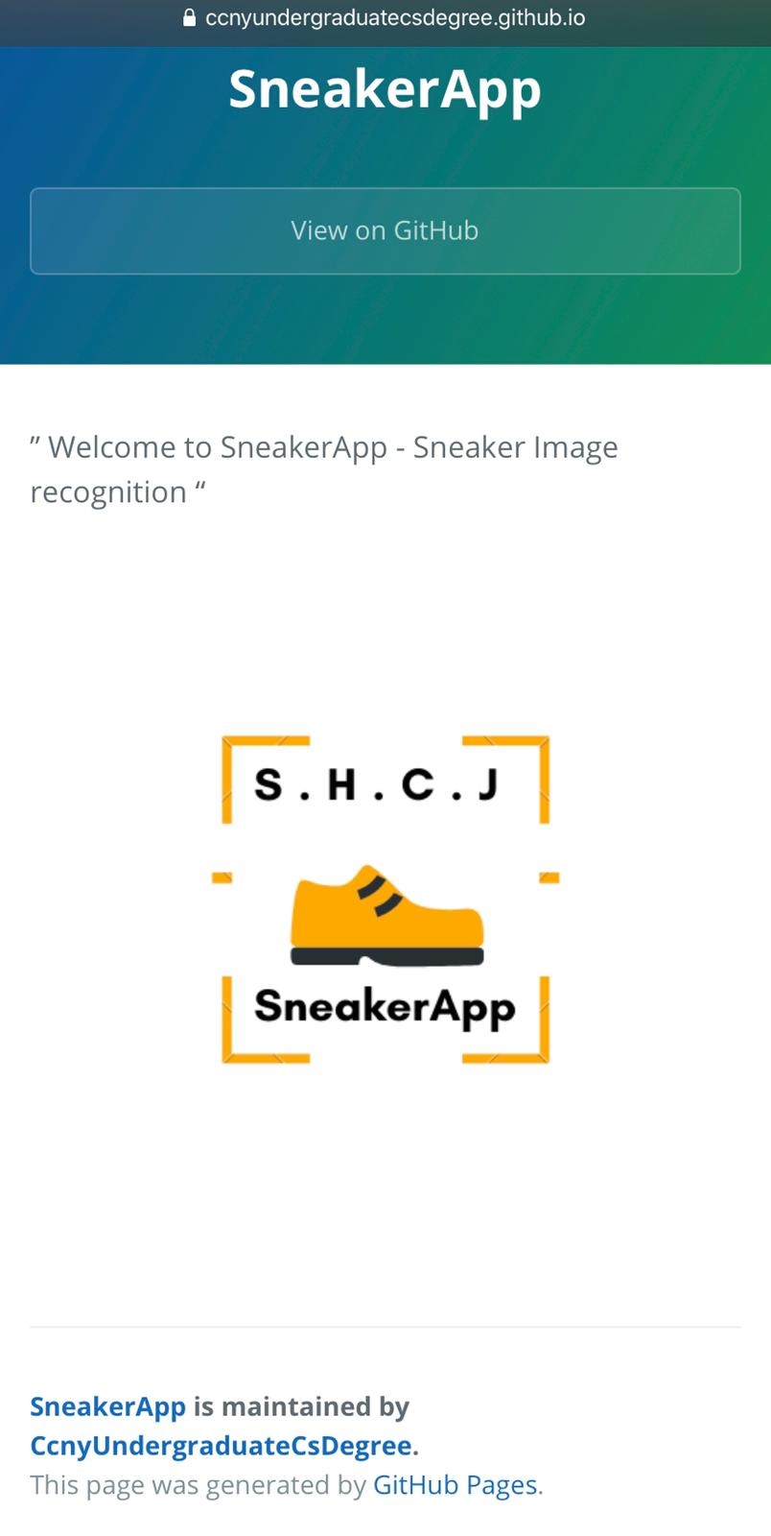
Github Website
Hasib and Carlos are working on the github website to showcase our final project. This will read our team repository.
https://ccnyundergraduatecsdegree.github.io/SneakerApp/

Slide 5
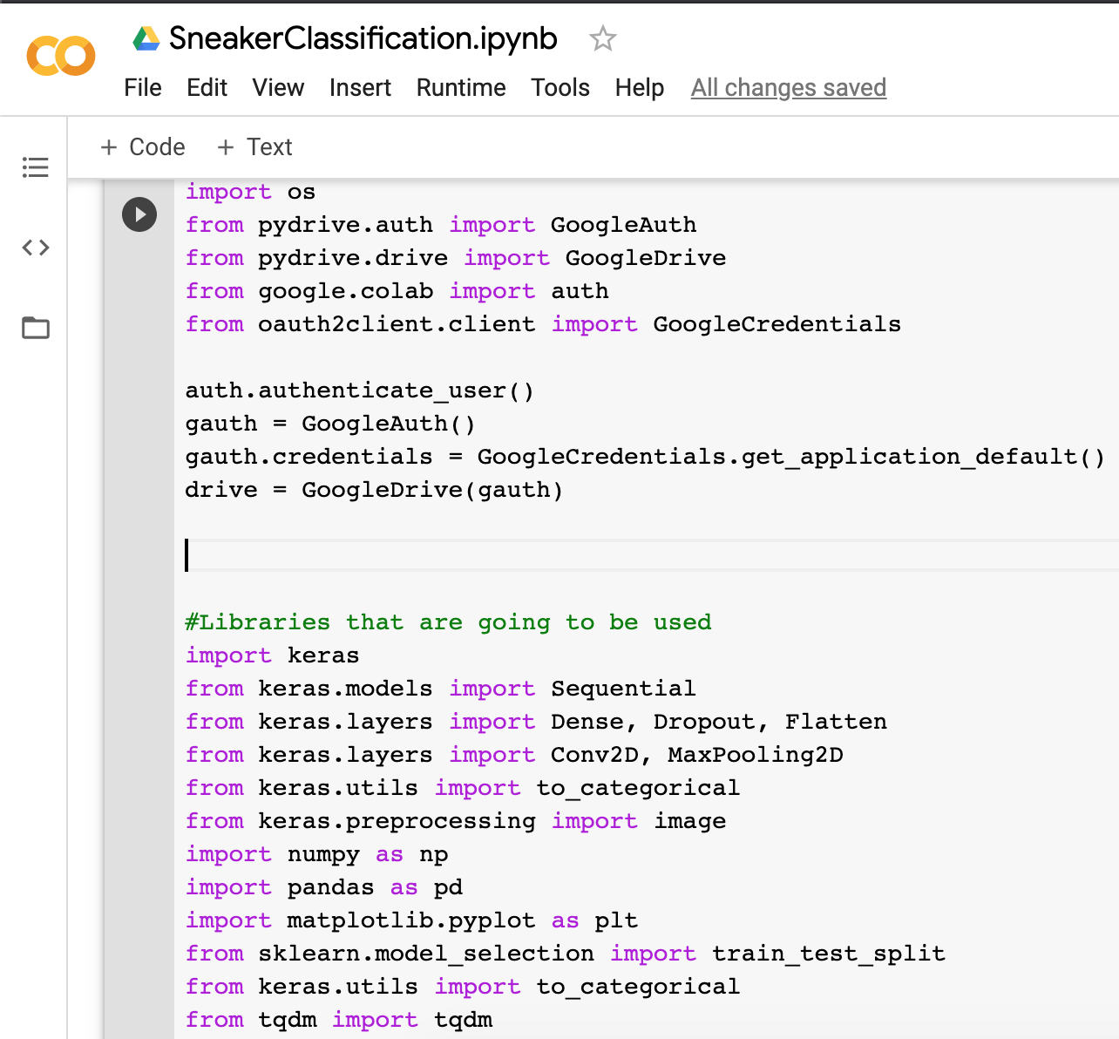
Google Colab Work
The team is now working on creating the script on google colab and for this week we only setup the environment and are planning to use different models that we used in the past to achieve the best accuracy possible.

Slide 6
What we plan to do between today and next meeting?
Continue development on Google Colab neural network.
Continue development on Github page to present project on.

Slide 7
Thank YOU!

